Slide 1
Gaussian Mixture Model

Slide 2
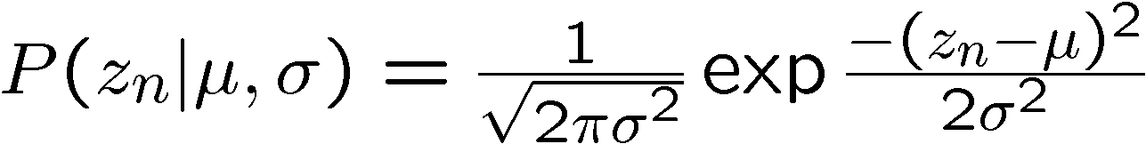
Fit this distribution with a Gaussian

Slide 3
Univariate Normal Sample
Sampling
σ
μ

Slide 4
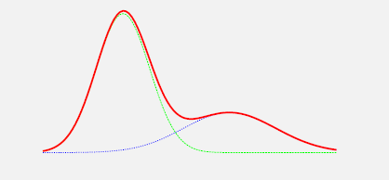
Problem:
Describe data with Mixture Model(MM)
Approach:
Decide on MM, e.g.
Gauss distribution
Mix of two
Estimate parameters

Slide 5
Gaussian Mixture Model (GMM)
Assume that the dataset is generated by two mixed Gaussian distributions
Gaussian model 1:
Gaussian model 2:
If we know the memberships for each bin, estimating the two Gaussian models is easy.
How to estimate the two Gaussian models without knowing the memberships of bins?

Slide 6
Review
Stochastically independent
Bayes’ rule
Logarithm
Expectation

Slide 7
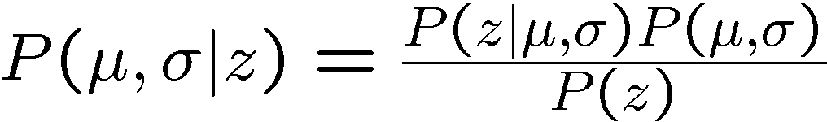

How find the parameters of the best-fitting Gaussian?
Posterior probability
Likelihood function
Prior probability
mean
data points
std. dev.
Evidence
By Bayes rule

Slide 8
How find the parameters of the best-fitting Gaussian?
Posterior probability
Likelihood function
Prior probability
mean
data points
std. dev.
Evidence
Maximum likelihood parameter estimation:

Slide 9
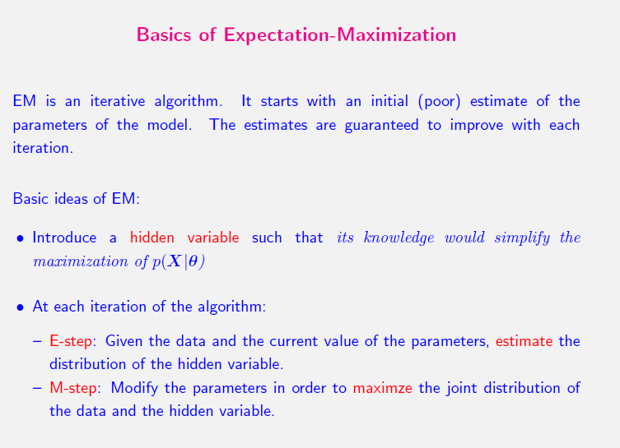

Slide 10
Goal
Mixture Model
subject to
To maximize:

Slide 11
Mixture Model
Correlated with α_{l} only.
Correlated with θ_{l} only.
subject to
To maximize:

Slide 12
Finding α_{l}
Due to the constraint on α_{l}’s, we introduce Lagrange Multiplier λ, and solve the following equation.

Slide 13
Finding α_{l}
1
N
1

Slide 14
Finding α_{l}

Slide 15
Finding θ_{l}
Only need to maximize
this term
Consider GMM
unrelated

Slide 16
Finding θ_{l}
Only need to maximize
this term
Therefore, we want to maximize:
How?
knowledge on matrix algebra is needed.
unrelated

Slide 17
Finding θ_{l}
Therefore, we want to maximize:

Slide 18
Summary
EM algorithm for GMM
Given an initial guess Θ^{g}, find Θ^{new} as follows
Not converge

